Slide 1
SNAKE GAME

Slide 2
Introduction :-
It is a basic level game designed using data structure “Array” .
In it a snake moves according to the instructions given by us and eats food.
When it eats food its tail increases and score get incremented.
The Game Overs when the snake touches itself or the boundary.

Slide 3
AIM & OBJECTIVES:-
Learn the programming language by its direct implementation.
The main purpose of the this game is understand how to use our programming and conceptual skills practically.
Making this game leads to the better understanding in concepts of programming language.

Slide 4
Initialization Function In The Game
Snake
Food
Score

Slide 5
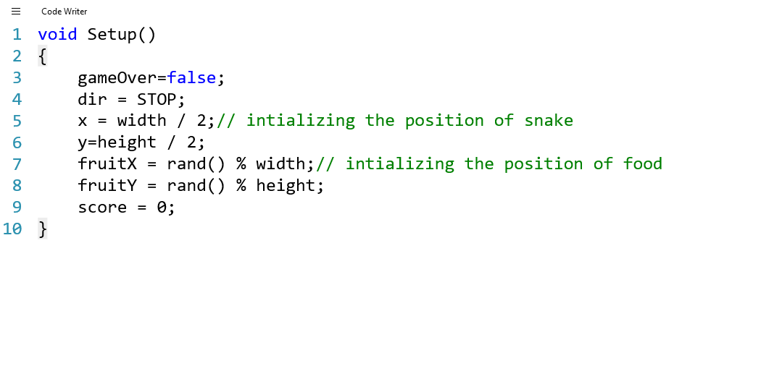

Slide 6

Input function:-

Slide 7
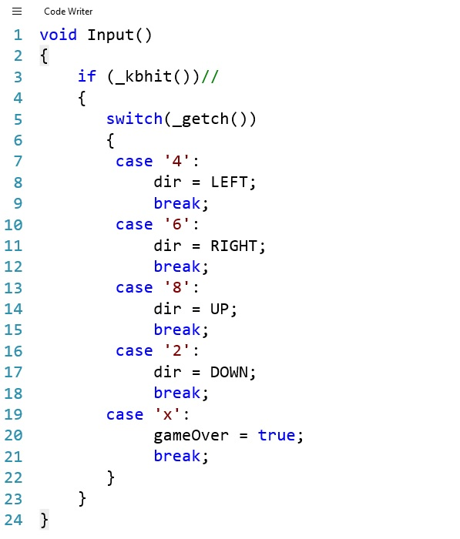

Slide 8
Draw Function (For Display Purpose)
Boundaries
Snake
Food

Slide 9
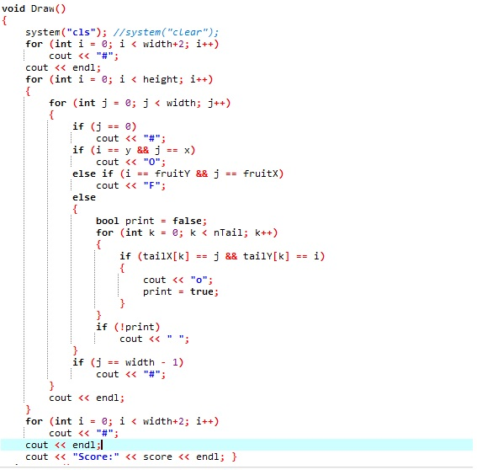
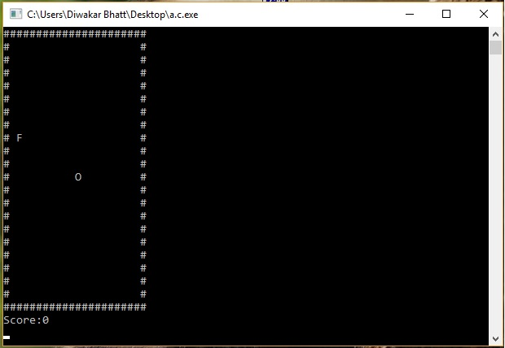

Slide 10

Logic Function:-

Slide 11
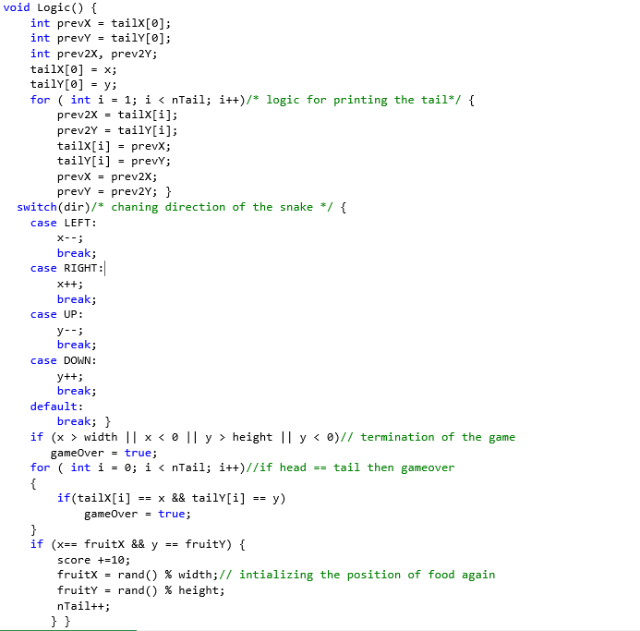

Slide 12
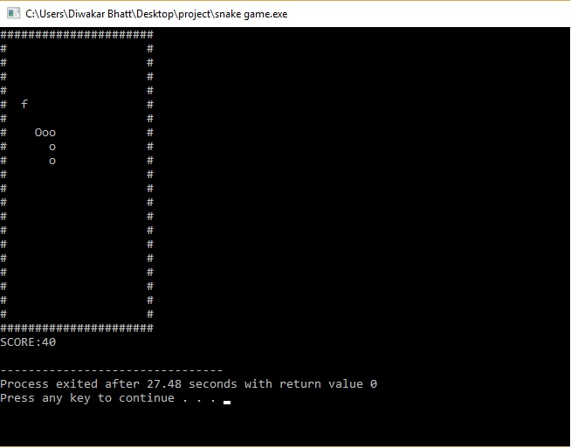
Execution of the game:-

Slide 13


